Slide 1

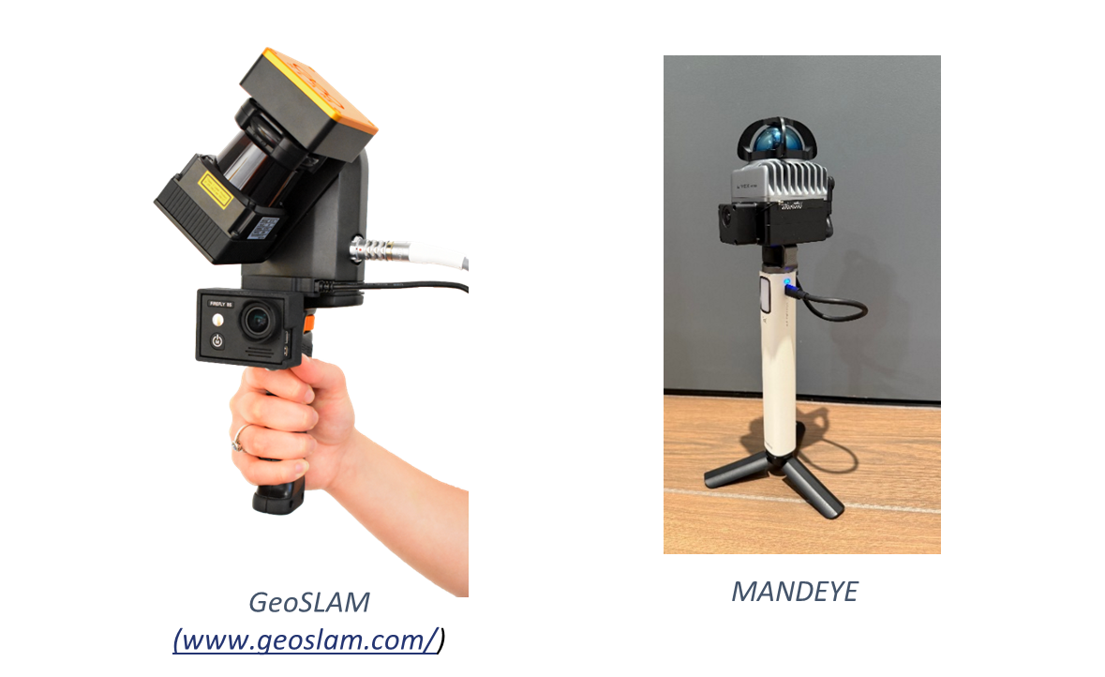
MLS for the NABVI project: Mandeye
A LiDAR-based mobile mapping device that records 3D data using the integrated Livox Mid-360 LiDAR sensor and an internal IMU.
USB
Power cable
Power Bank
Reference: Będkowski, J. (2024) ‘Open source, open hardware hand-held mobile mapping system for large scale surveys’, SoftwareX, 25, p. 101618. doi: 10.1016/j.softx.2023.101618. GitHub - MapsHD/HDMapping

Slide 2
Workflow: 1. Field Data Acquisition
Set up the device:
Place handheld system steadily on the ground.
Connect to power bank (white stick) via USB-C cable.
Device turns on automatically and beeps every ~10 s.
Data Acquisition:
Walk at normal speed
LiDAR tilted ~30° for ground coverage.
Return to starting point to close the SLAM loop.
Disconnect USB-C cable (after a beep), wait 2 s, remove USB.
Data saved under E:\continuousScanning_0000.

Slide 3
Workflow: 1. Field Data Acquisition
Set up the device:
Place handheld system steadily on the ground.
Connect to power bank (white stick) via USB-C cable.
Device turns on automatically and beeps every ~10 s.
Data Acquisition:
Walk at normal speed
LiDAR tilted ~30° for ground coverage.
Return to starting point to close the SLAM loop.
Disconnect USB-C cable (after a beep), wait 2 s, remove USB.
Data saved under E:\continuousScanning_0000.
What about GCPs?

Slide 4
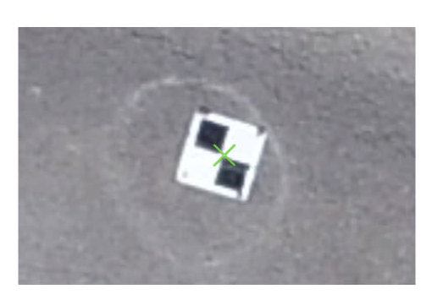
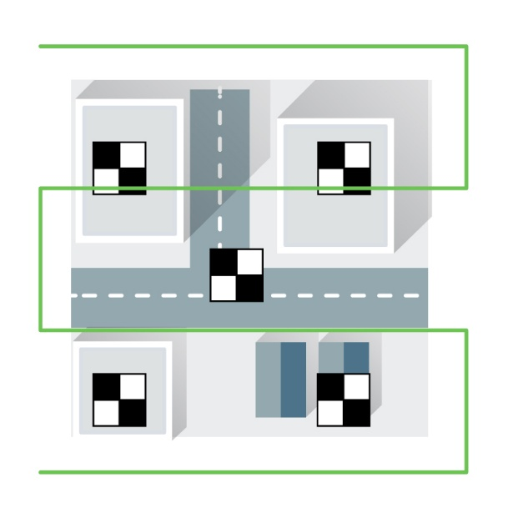
Workflow: 1. Field Data Acquisition
At each GCP:
Stop, place device above the GCP, hold still for a few
seconds (1–2 beeps).
Continue Data Acquisition.
GCPs serve as georeferencing references for the
trajectory and point cloud.

Slide 5
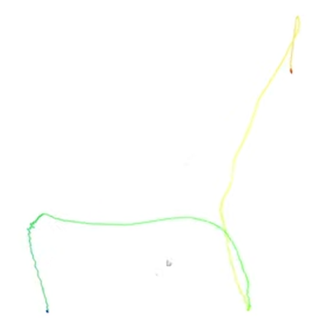
Workflow: 1. Field Data Acquisition
At each GCP:
Stop, place device above the GCP, hold still for a few
seconds (1–2 beeps).
Continue Data Acquisition.
GCPs serve as georeferencing references for the
trajectory and point cloud.
Example Trajectory

Slide 6
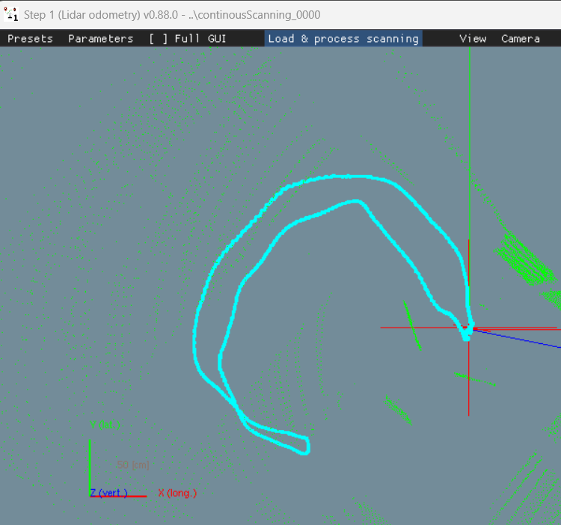
Workflow: 3. Data Processing
Step 1 – LiDAR Odometry (Trajectory & Point Cloud Calculation):
Open lidar_odometry_step_1.exe from E:\software.
Set parameters:
Click Presets → select “Velocity < 8 km/h”.
Load data:
Click Load & Process Scanning → select the folder E:\continuousScanning_0000.
The program will calculate the trajectory and build the point cloud.
At the end of the calculation, a message pops up indicating that Data saved to folder. Click OK.
Outputs:
Trajectory and point cloud stored in session.json

Slide 7
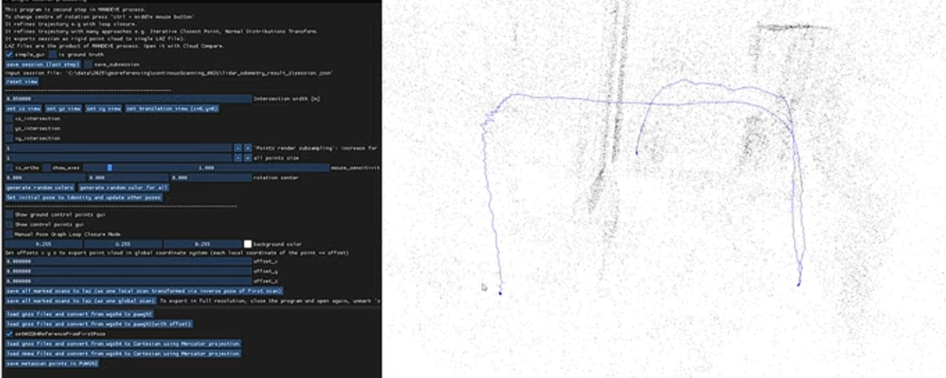
Workflow: 3. Data Processing - Georeferencing
Georeferencing the trajectory and point cloud
A detailed explanation of the process is available here.

Slide 8
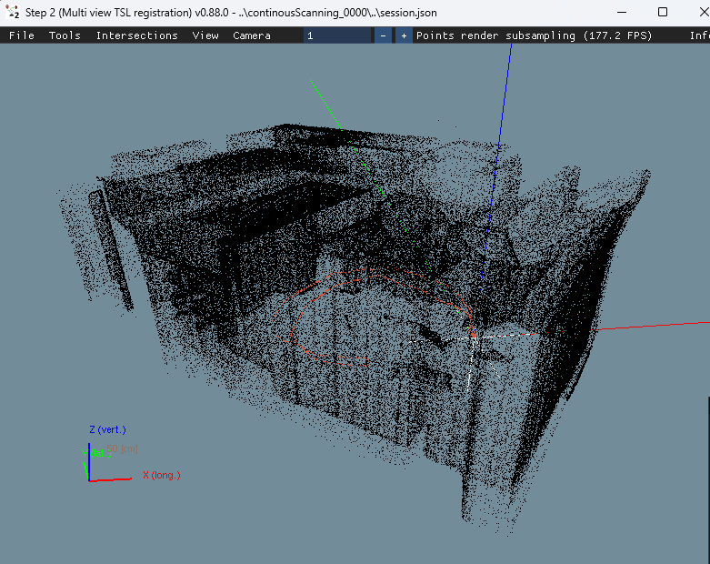
Workflow: 3. Data Processing
Step 2 – Session Refinement and Point Cloud Export
Open multi_view_tls_registration_step_2.exe from E:\software.
Load session:
File → Load Session → select the session.json from Step 1.
Visualization and refinement:
The window displays the point cloud and trajectory.
Adjust the rendering resolution (reduce subsampling for more detail). Default is 1000.
Export global point cloud:
File → Save All Marked Scans → Global Scan → choose output name and location (e.g., scan_merged.laz).
Open with CloudCompare or other software.

Slide 9
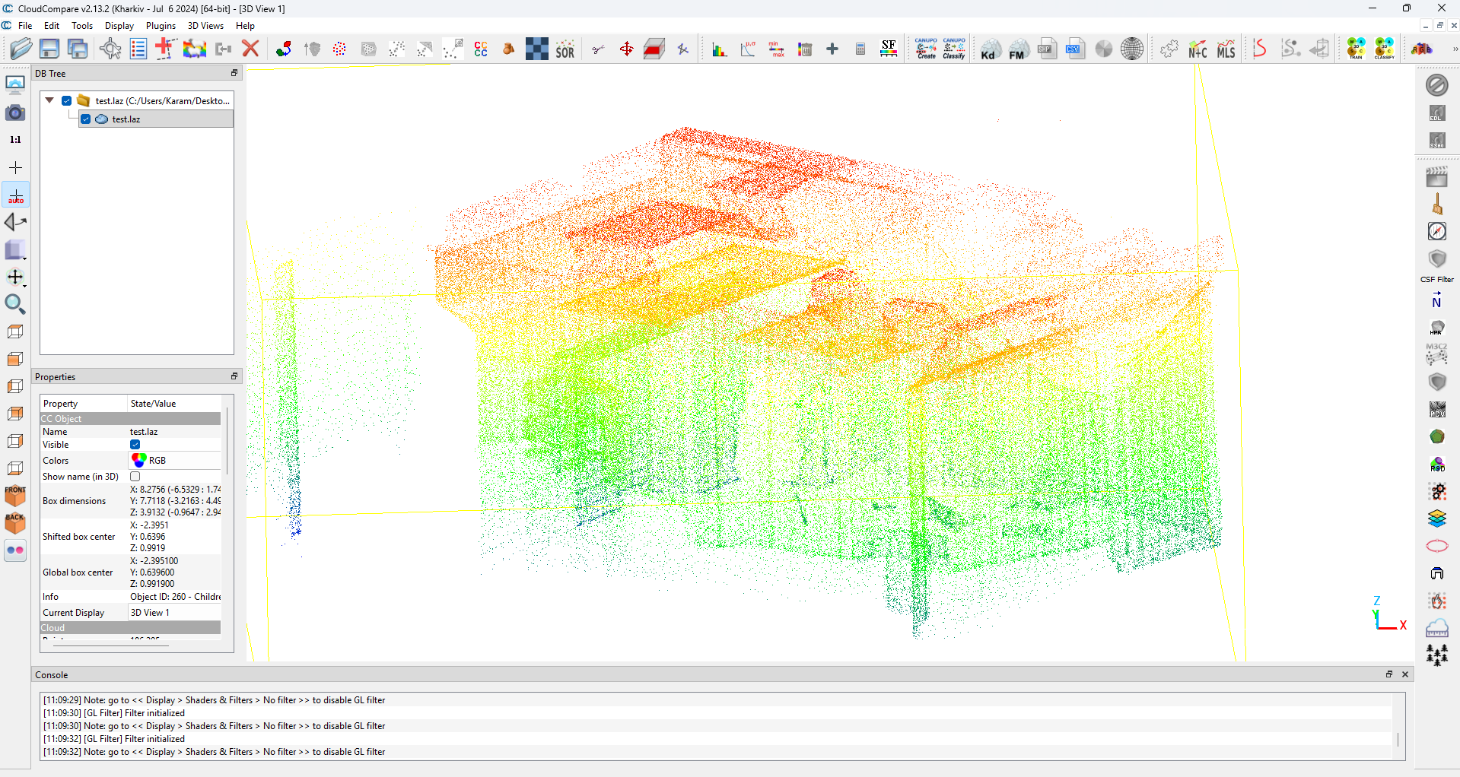
Workflow: 4. Output Visualization
Open the point cloud file (e.g., scan_merged.laz) with CloudCompare or other software.
Installation Link: CloudCompare - Downloads

